Slide 1


FortiGate Security
Web Filtering
By Mina Maher

Slide 2




Objective of the lab
Apply FortiGuard category-based web filtering.
FortiGuard
Troubleshoot the web filter
Read and interpret web filter log entries

Slide 3
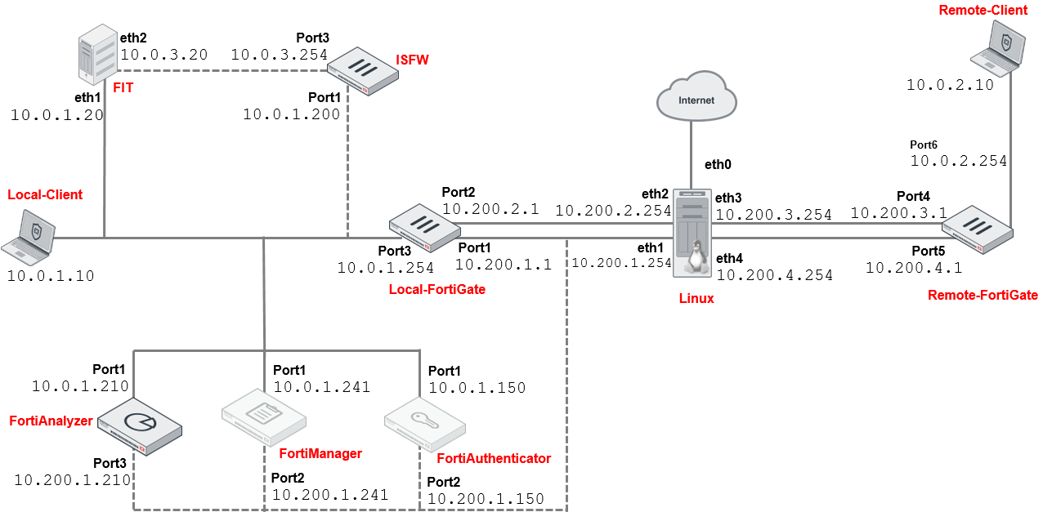
Network Topology

Slide 4

Components used
FortiGate: Next-gen firewall providing network security with features like intrusion prevention, VPN, and web filtering.
FortiAnalyzer: Centralized logging and reporting solution for analyzing network traffic and security events.
FortiManager: Centralized management platform for Fortinet devices, offering configuration and policy management.
Forti Authenticator: is a solution for secure user authentication, offering MFA, SSO, and RADIUS support. It integrates with Fortinet products to manage and control network access.

Slide 5



Lab
Steps
Set up web filtering on FortiGate with FortiGuard categories and test authentication.
Start Slide
www.depi.gov.eg

Slide 6
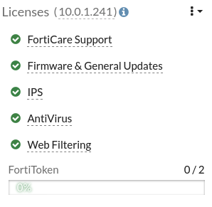
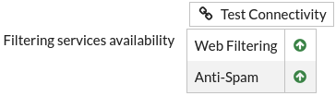
Verify License
01
Log in to the Local-FortiGate GUI with username and password .
On the Dashboard, locate the Licenses widget.
Confirm that the Web Filtering service is licensed and active (green checkmark).
If the status is Unavailable, navigate to System > FortiGuard, and under the Filtering section:
Click Test Connectivity to force an update.
Click OK to confirm.
admin
password

Slide 7
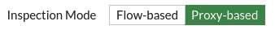
Verify Inspection Mode
Go to Policy & Objects > Firewall Policy.
Double-click the Full_Access policy to edit it.
Under Inspection Mode, confirm that it is set to Flow-based.
Change the mode to Proxy-based if required, and click OK.
02

Slide 8
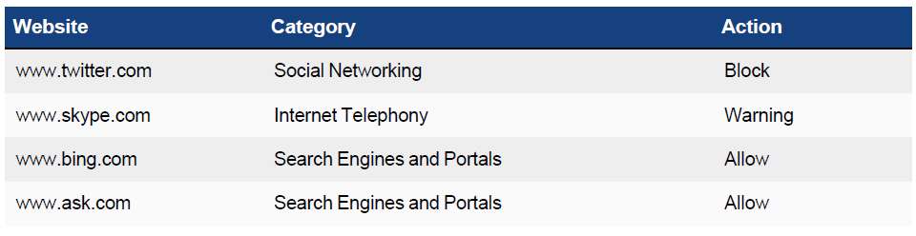
Determine Web Filter Categories
Use the FortiGuard Web Filter Lookup Tool:
On the Local-Client VM, open a browser tab and go to FortiGuard Web Filter Lookup.
Search for the following URLs to determine their categories: www.twitter.com
www.twitter.com: Should fall under the Social Networking category.
Use the Web Filter Lookup tool to find the categories for additional websites.
03

Slide 9
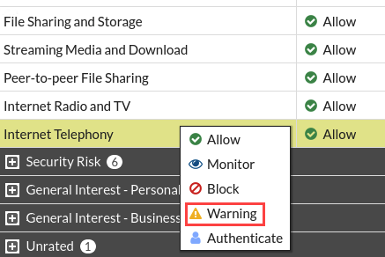
Configure FortiGuard Category Filter
Access the Local-FortiGate GUI, go to Security Profiles > Web Filter, and double-click the default profile to edit it.
Ensure the FortiGuard Category-Based Filter is enabled and review the default actions for each category.
Example Actions:
Block: Extremist Groups, Adult Content.
Allow: General Interest (Business, Personal).
Warning: Internet Telephony (Bandwidth Consuming).
Modify actions for categories as needed (e.g., block Social Networking, set Internet Telephony to warning).
Save Profile: Click OK to save changes.
04

Slide 10
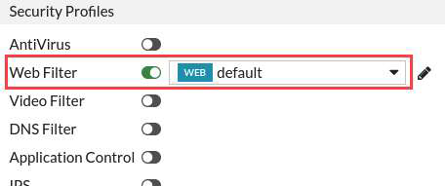
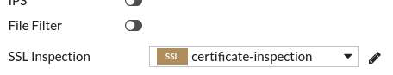
Apply Web Filter Profile to Firewall Policy
Continuing on the Local-FortiGate GUI, click Policy & Objects > Firewall Policy.
Double-click the Full_Access policy to edit it.
In the Security Profiles section, enable Web Filter, and then in the drop-down menu, select default.
Under Log Allowed Traffic, make sure Security Events is selected.
Keep all other default settings, and then click OK.
| This step applies the configured web filter profile to a firewall policy to begin inspecting and controlling web traffic
05

Slide 11
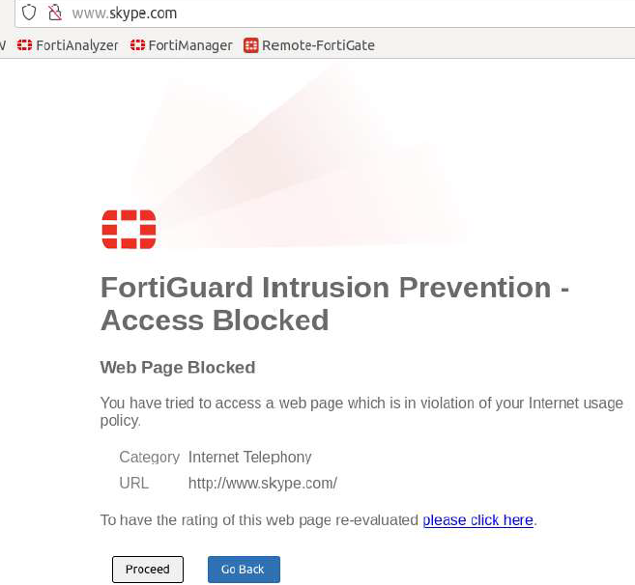

Verify Web Filter Status In the CLI, run the command confirm the web filter is active.
Test Blocked Categories :On the Local-Client VM, attempt to access a blocked website
Test Allowed Websites : Access websites that should be allowed
get webfilter status
Test the Web Filter

Slide 12
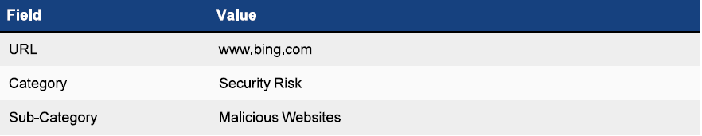
Override the category
Log in to FortiGate GUI and go to Security Profiles > Web Rating Overrides.
Create a new override for www.bing.com, set Category to Security Risk and Sub-Category to Malicious Websites, then click OK.
06

Slide 13
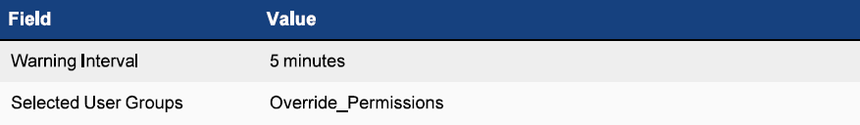
Set Action to Authenticate
Go to Security Profiles > Web Filter and edit the default profile.
Under FortiGuard Category Based Filter, right-click Malicious Websites and select Authenticate.
Set the Warning Interval to 5 minutes and choose Override_Permissions for Selected User Groups, then click OK.
07

Slide 14
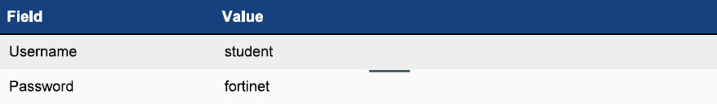
Define User and Group
Go to User & Authentication > User Definition, create a new Local User with the username student and password fortinet.
Assign the Override_Permissions user group to this user and click Submit.
08

Slide 15
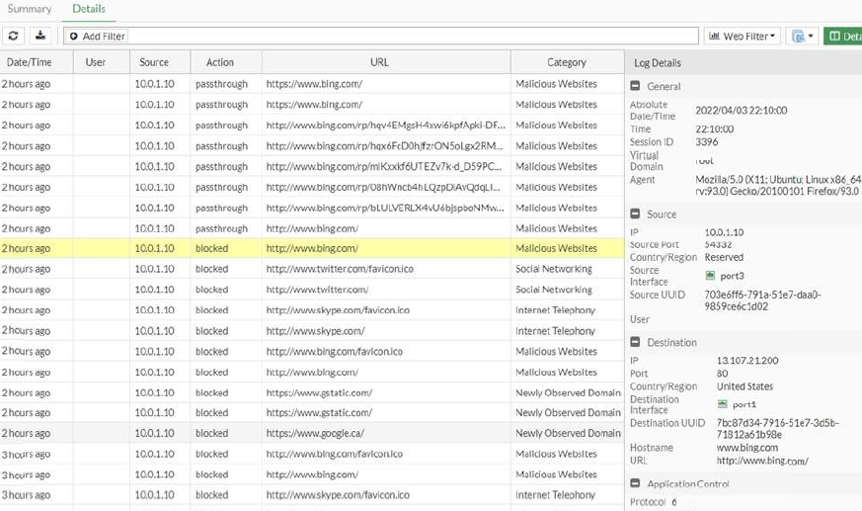
Test www.bing.com Access:
On the Local-Client VM, try accessing www.bing.com. A warning will appear.
Click Proceed, enter student credentials, and the website should load.
Check Logs: Go to Log & Report > Security Events and check logs for www.bing.com. initially, the action is Blocked, but after authentication, it changes to Passthrough.
Test Authenticate Action

Slide 16
Lab Results
Web Filtering: Websites categorized as Malicious Websites (e.g., www.bing.com) were successfully blocked, and allowed sites were accessible.
Authentication Action: Users were prompted for authentication on blocked sites and granted access after successful login.
Logs: Logs showed correct actions, with blocked sites marked as blocked and authenticated sites as passthrough.
Override Testing: The category override for www.bing.com was applied and worked as expected.
Performance: No delays or performance issues were observed during the filtering and authentication process.

